Slide 1

Mahakal Institute of Technology & Management, Ujjain (M.P.)
Minor Project – II Presentation
Guide Presented By
Prof. Imran Uddin Shubham Kushwah [0714CS211075]
Tushar Solanki [0714CS211085]
Yash Upase [0714CS211090]
Computer Science & Engineering Department, MITM, Ujjain (M.P.)

Slide 2
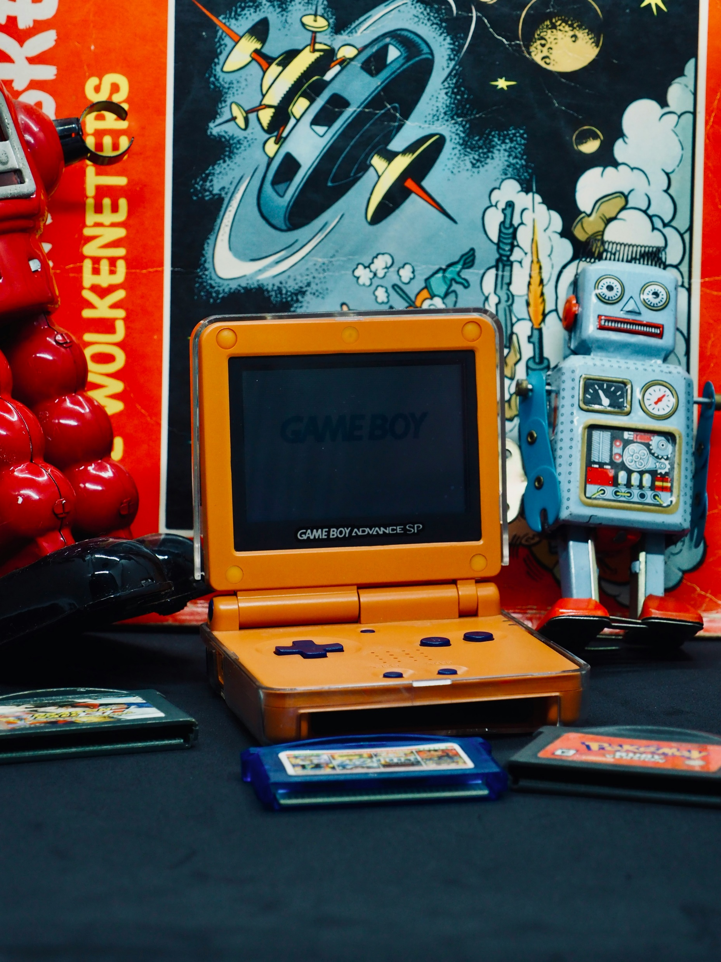
A Mini Game Website: GameZ
Minor Project Presentation on

Slide 3

Outline
Introduction
The Power of HTML, CSS, and JavaScript
Game Selection Process
Game Features and Functionality
GameZ: A Hub for Entertainment
User Experience and Interface Design
Future Developments and Expansion
Conclusion

Slide 4
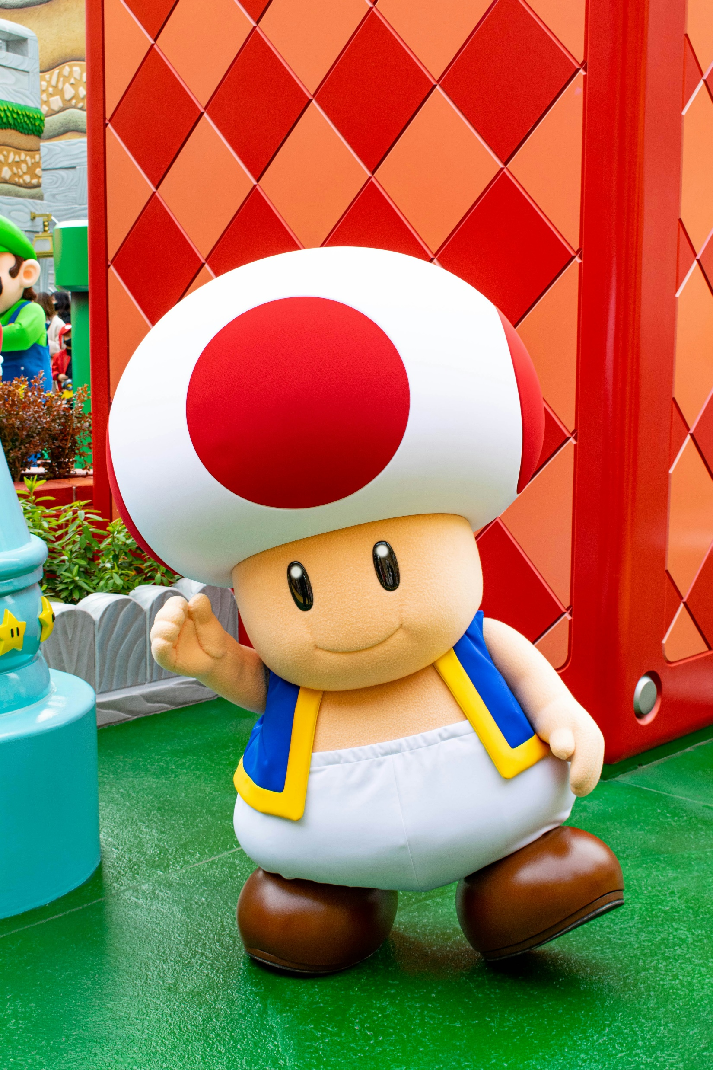
Introduction
Overview of the Mini Game Website: GameZ
Brief description of the games available
Importance of interactive and engaging games
Purpose of presentation

Slide 5

Overview of the Mini Game Website: GameZ
GameZ is your one-stop destination for a collection of interactive and engaging mini games developed using HTML, CSS, and JavaScript. Whether you're looking to challenge your strategic thinking, test your reflexes, or simply unwind with some fun and entertaining games, GameZ has something for everyone.
GameZ

Slide 6





Brief Description of the Games Available
Tic Tac Toe: A classic game for two players, where each player takes turns marking spaces in a 3x3 grid with the symbols (usually "X" and "O"). The player who succeeds in placing three of their marks in a horizontal, vertical, or diagonal row wins the game.
Rock Paper Scissors: A simple game usually played between two people, where each player simultaneously chooses one of three shapes: rock, paper, or scissors. The winner is determined based on the rules: rock crushes scissors, scissors cuts paper, and paper covers rock.
Guess the Number: A guessing game where the player selects a random number within a specified range, and player has to guess the number within a limited number of attempts.
Quiz Game: A trivia game where players answer questions on various topics. Players earn points for correct answers and highest score.

Slide 7
Brief Description of the Games Available
Flappy Bird: An addictive game where players control a bird by pressing any key to make it fly and navigate through a series of pipes. The goal is to fly as far as possible without colliding with the pipes or hitting the ground.
Snake: A classic arcade game where players control a snake that grows longer as it consumes food items placed randomly on the game board. The objective is to guide the snake to eat as much food as possible without colliding with the walls or its own tail.
Tetris: A tile-matching puzzle video game where players manipulate geometric shapes called Tetriminos as they fall down the game field. The goal is to create horizontal lines without gaps by rotating and moving the Tetriminos, causing them to disappear and earn points.
Slide Puzzle: A puzzle game where an image is divided into a grid of squares, with one square missing. Players rearrange the squares by sliding them into the empty space to recreate the original image.

Slide 8

Importance of Interactive and Engaging Games
Interactive and engaging games play a crucial role in providing entertainment, stimulating cognitive abilities, and fostering social interaction. By offering a variety of mini games with intuitive gameplay mechanics and captivating visuals, GameZ aims to enhance user engagement, promote skill development, and provide a memorable gaming experience for our players.

Slide 9

Purpose of Presentation
Our goal at GameZ is to create a platform that not only entertains but also inspires creativity, encourages exploration, and fosters a sense of community among gaming enthusiasts. Through this presentation, we aim to introduce you to the exciting world of mini games available on our website, showcase the diversity of our offerings, and invite you to embark on a thrilling gaming adventure with GameZ.

Slide 10
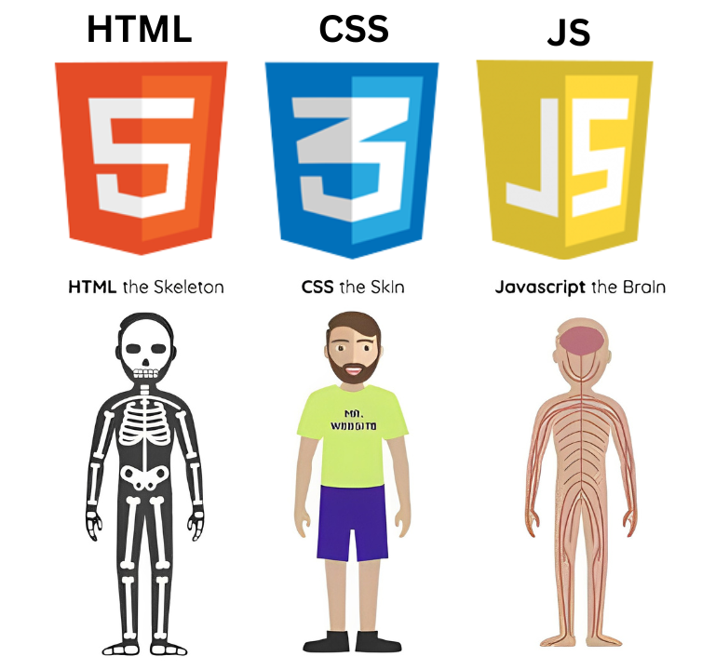


Technology Used

Slide 11
The Power of HTML, CSS, and JavaScript
Explanation of HTML for web structure
Importance of CSS for design and layout
Role of JavaScript in adding interactivity
How the combination enhances user experience

Slide 12
Explanation of HTML for web structure
HTML (Hypertext Markup Language): HTML is the standard markup language used to create the structure and content of web pages. It consists of a series of elements or tags that define the various parts of a webpage, such as headings, paragraphs, images, links, and forms. HTML provides the basic foundation for building web pages and organizing content in a structured manner.

Slide 13
Importance of CSS for design and layout
CSS (Cascading Style Sheets): CSS is a style sheet language used to control the presentation and layout of HTML documents. It allows developers to apply styles, such as colors, fonts, spacing, and positioning, to HTML elements, thus enhancing the visual appearance of web pages. CSS enables the separation of content and presentation, making it easier to maintain and update the styling of a website across multiple pages.

Slide 14
Role of JavaScript in adding interactivity
JavaScript: JavaScript is a versatile programming language used to add interactivity and dynamic behavior to web pages. It runs client-side in the web browser, enabling developers to create interactive features such as animations, form validation, user interface enhancements, and more. JavaScript can manipulate HTML and CSS elements, respond to user actions, and communicate with web servers to fetch or send data asynchronously, enabling rich and responsive web experiences.

Slide 15
Tailwind CSS as a helping hand
Tailwind CSS is a utility-first CSS (Cascading Style Sheets) framework with predefined classes that you can use to build and design web pages directly in your markup. It lets you write CSS in your HTML in the form of predefined classes.

Slide 16
Firebase for backend
Firebase is a product of Google which helps developers to build, manage, and grow their apps easily. It helps developers to build their apps faster and in a more secure way. No programming is required on the firebase side which makes it easy to use its features more efficiently. It provides services to Android, iOS, Web, and Unity. It provides cloud storage. It uses NoSQL for the database for the storage of data.

Slide 17

Game Selection Process
Criteria for selecting games for GameZ
Popular games included in the website
Variety of games to cator to different preferences

Slide 18

Game Features and Functionality
Overview of the features available in each game
How the games are designed to be user-friendly
Interactivity and engagement elements within the games
Accessibility and compatibility across different devices

Slide 19

GameZ: A Hub for Entertainment
How GameZ provides a one-stop destination for mini games
Importance of having a diverse range of games
Creating an immersive gaming experience for users
Encouraging repeated visits through engaging content
GameZ

Slide 20
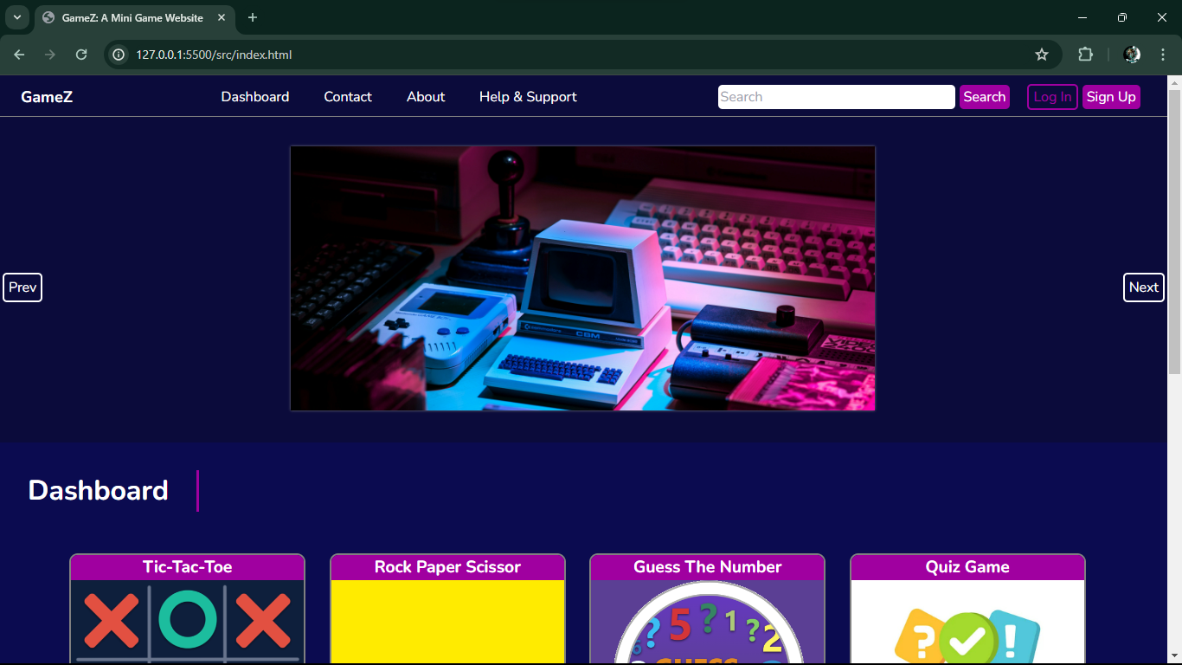
Snapshot of Project: GameZ

Slide 21
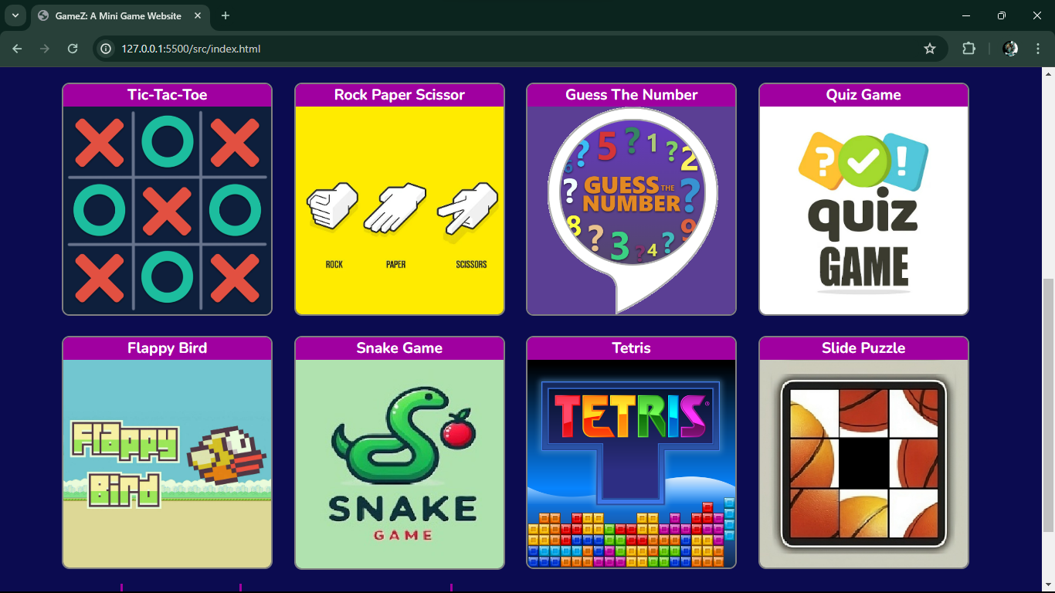
Snapshot of Project: GameZ

Slide 22

User Experience and Interface Design
Focus on creating a seamless user experience
Importance of intuitive interface design
Incorporating feedback for continuous improvement
Ensuring responsive design for optimal performance

Slide 23

Future Developments and Expansion
Plans for adding new games and features to GameZ
Incorporating user suggestions and feedback in future updates
Expanding the website to include more interactive elements
Keeping up with trends in the gaming industry

Slide 24

Conclusion
Recap of the key points discussed in the presentation
Emphasizing the value of GameZ as a mini game website
Call to action for users to visit and explore the website
Thanking the audience for their attention and interest

Slide 25
‘For Your Time and Attention’.
Thank You!

